Slide 1
New Reception Parent Information 2023
We are so pleased that your child has been offered a place here at Ludlow Primary School, starting in the academic year 2022. On behalf of the Staff, children and parents, it gives me great pleasure to welcome you and your family to our school community.
Mrs. Kate Mather

Slide 2
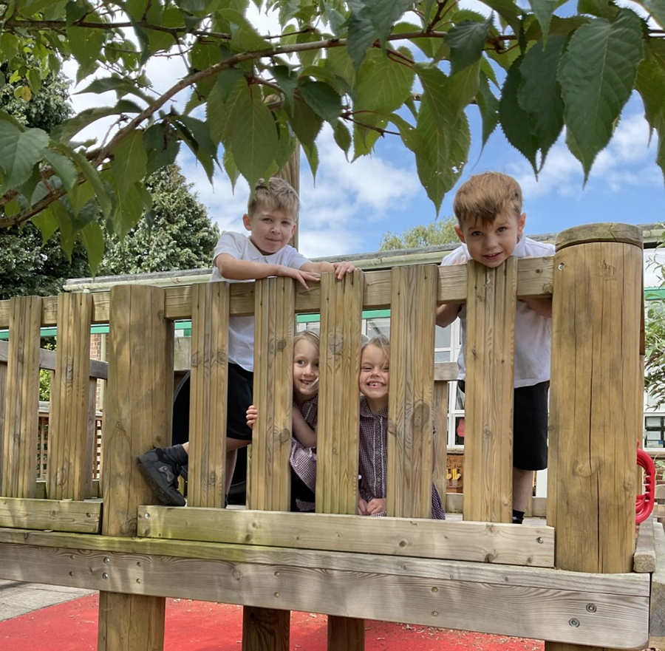
Welcome to Ludlow Primary School, we are delighted that your child will be starting with us in September.
As you came in, you will have been given a registration pack. Please ensure that you complete these as soon as possible and return them to the school office and no later than Friday 9th June 2023.
The Reception staff will be arranging to visit nursery settings that your children attend and have fun meeting the children and getting to know them.
Following this PowerPoint, if you have any questions please do not hesitate to get in touch!

Slide 3
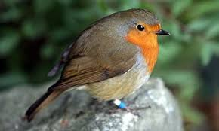
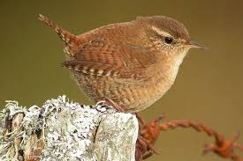
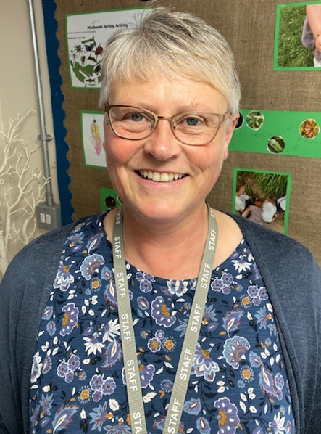
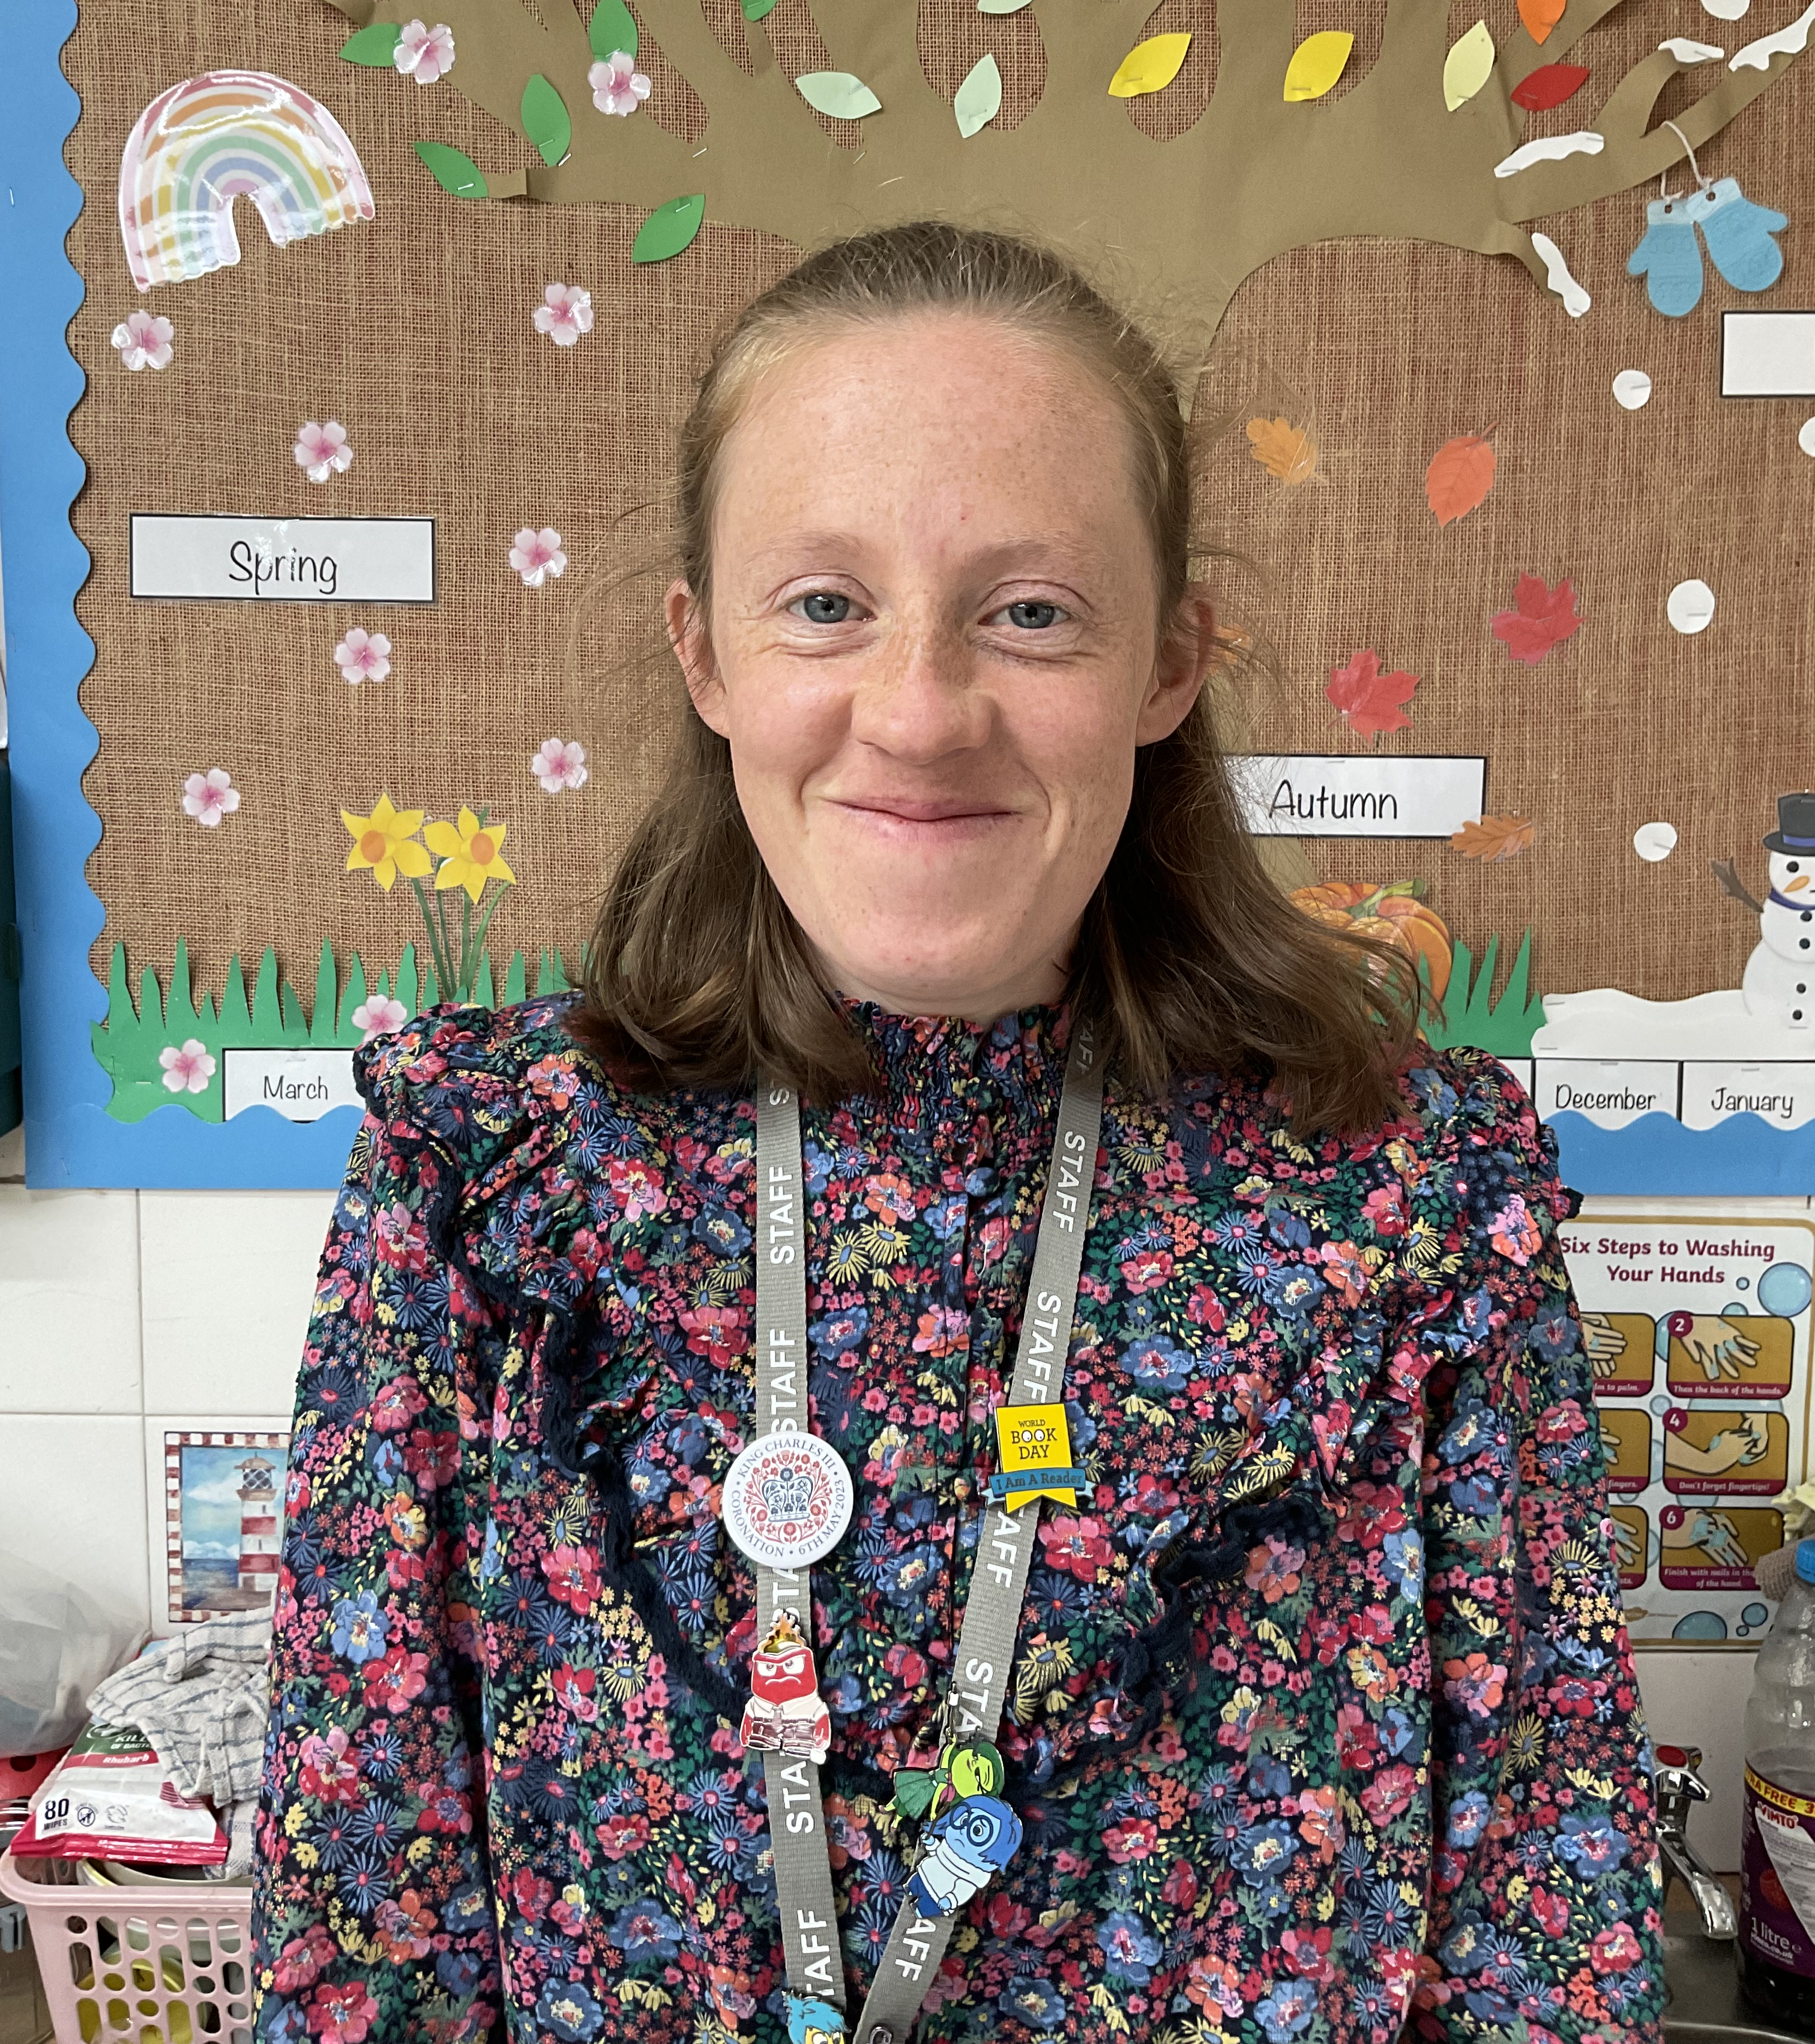
There are two classes in Reception, Robins and Wrens.
Meet the teachers:
Mrs. C. Preece (Robins Class Teacher and Early Years Lead)
Miss T. Preece (Wrens Class Teacher)
The classes are supported by:
Mrs. Badham, Mrs. Seabourne and Mrs. Duppa

Slide 4
School Uniform
Plain white polo shirt
Dark grey skirt/trousers
Maroon sweatshirt with school logo
Plain black shoes (no logos) Velcro or pull on shoes are best for reception.
PE Uniform
Plain white round necked t-shirt
Plain black shorts/leggings (no logos)
Plain black/navy sweatshirt (no logo unless wearing a school PE hooded sweatshirt)
Plain black/navy jogging bottoms
Jewellery is limited to one watch, plain stud earrings or sleepers. These need to be removable for PE lessons/clubs.

Slide 5
PLEASE ENSURE ALL UNIFORM AND PE KIT ARE NAMED

Slide 6
Ordering Uniform
The school logo items can be ordered on-line at www.schooluniformfactory.co.uk. Please click on Ludlow Primary School on the left hand side to see the range of items available. You will need a paypoint account or to pay with a credit/debit card, please telephone 01746 761701. All orders can be delivered to school free of charge or to a home address for extra postage.
Please put your child’s name in all their clothing so it can be easily identified

Slide 7
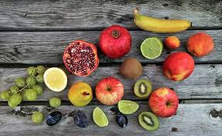
Snack
The children are offered a healthy snack during the morning session.
We are a healthy eating school committed to encouraging our pupils to adopt a healthy lifestyle. As part of this we encourage pupils to bring in a piece of fresh fruit and offer a short break for them to eat this each morning. Please do not send in cereal bars or other processed foods.
In Key Stage 1, children are provided with fresh fruit free of charge under the government funded School Fruit and Vegetable Scheme.
Drinks
Your child should bring their own water in their own named drinks bottle daily.
Children have access to water throughout the day and we encourage them to drink regularly.

Slide 8
Lunch
Class Reception go for lunch at 11.45am and eat in the hall. They then get the chance to go outdoors on to the main playground.
School Meals
All of our school meals are freshly cooked in school at our Clee View site kitchen, using local suppliers where possible and following healthy living guidelines. All children in reception and key stage 1 classes have a school meal provided.
You can view our current menu by clicking on the link on the website.

Slide 10
Over the year our Early Years curriculum looks like this…
• Quality indoor and outdoor learning focusing on all areas of the curriculum.
• Fun and exciting project related learning.
• Practical, real-purpose, hands on experiences.
• Mixture of child-initiated and adult led activities.
• Risk taking - developing resilience and independence.
• Enrichment and trips to embed learning.

Slide 11
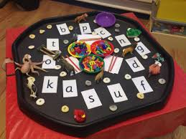
Either weekly or daily these are some of the activities your children will be involved in:
• Daily phonics sessions
• Guided Reading and Guided Writing Groups
• Daily Maths Sessions
• Indoor and Outdoor areas of provision to embed learning
• PE sessions
• Class and KS1 assembly
• Well done assembly
• Playtime and Lunch Time with the whole school

Slide 12
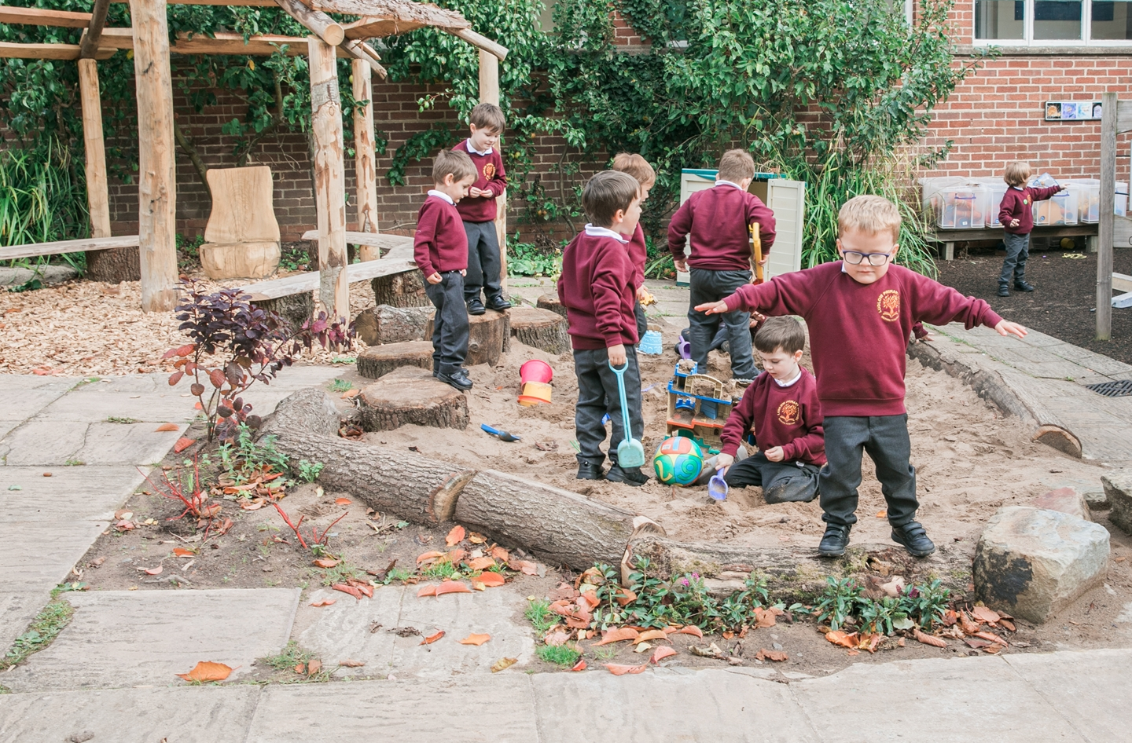
On their first day please ensure your child has:
• A book bag
• Waterproof Coat
• Sun hat and sun cream (weather depending)
• Water Bottle (named)
• Spare Clothes if needed i.e. pants
• Please ensure your child’s school uniform is named.

Slide 13
Preparation for school
If you can please help your child with the following:
• Support your child to be toilet trained and use the toilet independently where possible.
• Hygiene and hand washing should be encouraged.
• To be able to get dressed independently.
• To be able to use a knife and fork.
• To be able to learn how to share with others and take turns.
• To be able to develop organisational and independence skills for the school day i.e. carry their own bag into school.

Slide 14
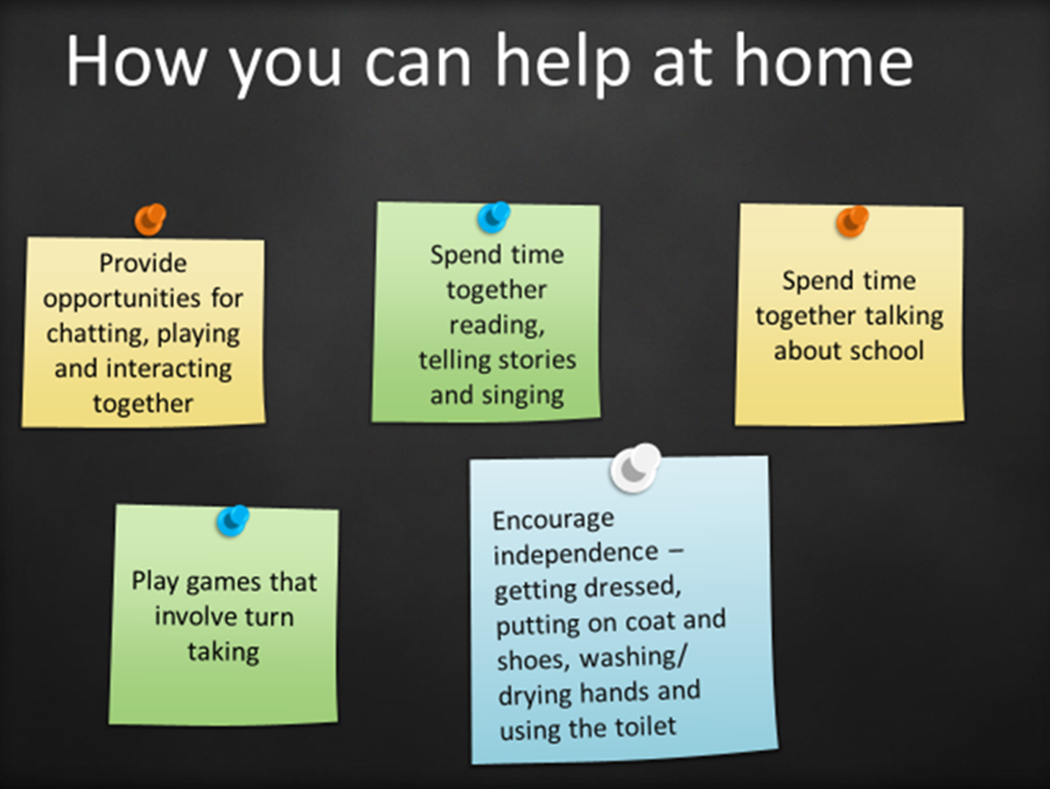
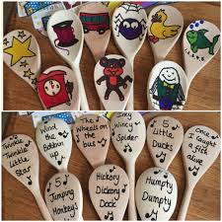
Encourage your child to recognise their name and belongings by labelling everything clearly (coat, jumper, book bag,
lunchbox etc.)
Sharing books together daily helps your child develop a love of books and stories.
Develop fine motor skills by threading, using dough, small tweezers, rolling tissue paper or any other activities to let little fingers move.
Play counting games.
Recite nursery rhymes including number songs.

Slide 15
Attendance
We cannot emphasise enough the importance of your child attending school every day.
Regular school attendance is an important part of giving children the best possible start in life. The aim should be to attend 100% of the time. Children who miss school frequently can fall behind with their work and do less well. Being in school is important to your child’s achievement, wellbeing, and wider development.
Please do not book holidays during term time.

Slide 16
Parent Partners
Active partners – we are always here to support both you and your child and want to welcome you into our school community.
• We will offer sessions where you can come and learn in school with your child..
• You may want to volunteer with us to either listen to readers or support us on trips.
• You could join our PTA group!
Home School Partnership
We know that communication is key between home and school and we have an open door policy. Please come and speak to us if you need to.
• Photos of your child’s learning will be shared through Tapestry. This is an online learning journal on which we record photographs and comments and you, as parents can record comments and observations.
• We will share a Newsletter every half-term with pictures of events across Reception.
• We will have two parents evenings (Autumn and Spring) and you will receive a report in the summer term.
• Our website will also hold all the information you need.

Slide 17
Meet the Teachers
When your child joins us in September they will be placed in either Robins or Wrens class. This will be for registration purposes, as well as some teacher led activities and group work, for the remaining part of the day, your child will have the opportunity to access the whole of the reception area and outdoor space.
Your child will have had an opportunity to meet the teachers prior to our “meet the teacher” session and of course during nursery visits.
On Tuesday 4th July your child will be invited to come into school to spend the morning in their new class. Please bring your child to the school gates at 9.15 am where you will be shown into the hall and informed which class your child will be in. You will then be able to go down to the classroom, settle your child and then leave. Children will be collected from the side gate (next to Tree Tops) at 11.30 am.
All children will start school full time on Wednesday 6th September 2023

