Slide 1
4.3.21
Recap Equivalent Fractions

Slide 11
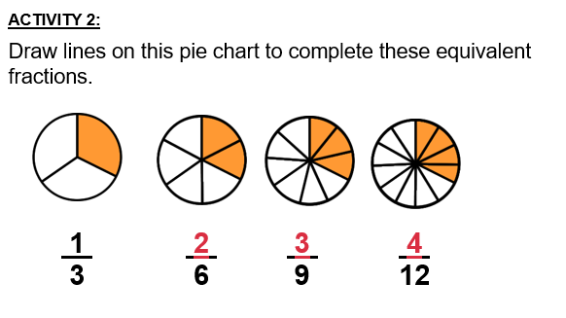

Slide 12
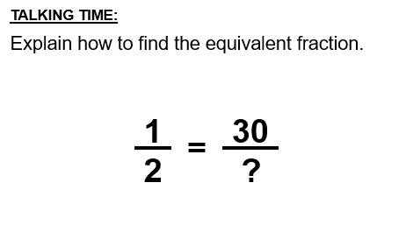

Slide 14
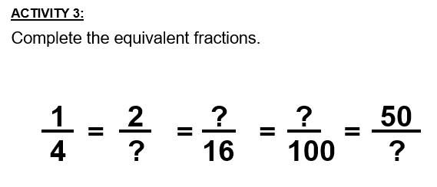

Slide 15
