Slide 2
Early Life
Alexander Bell was born in March, 1847 in Edinburgh, Scotland.
He had two brothers, Melville James Bell and Edward Charles Bell.
Bell’s father, Alexander Melville Bell, was a phonetician, which is a scientist who studies speech sounds and how they are made and transmitted.
His mother was Eliza Grace Bell, and she was an accomplished pianist.
Bell was home-schooled by his mother, who tried to give him a sense of curiosity about the world around him.
To his close friends and family, Alexander Bell was known by the nickname Aleck.

Slide 3
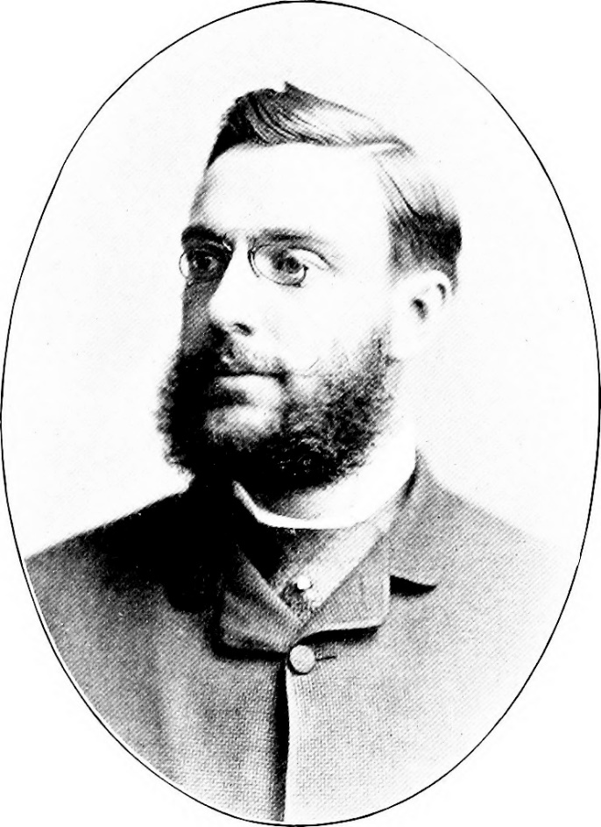
The Telephone
In the early 1870s, Bell was living and teaching in Boston, America. He spent years trying to develop a device to transmit the human voice over electrical wires.
In 1874 he began working with Thomas Watson, a skilled electrician. Together, they continued experimenting and developing a way to transmit speech.
Thomas Watson
Photo courtesy of internetarchivebookimages (@flickr.com) - granted under creative commons licence – attribution

Slide 4
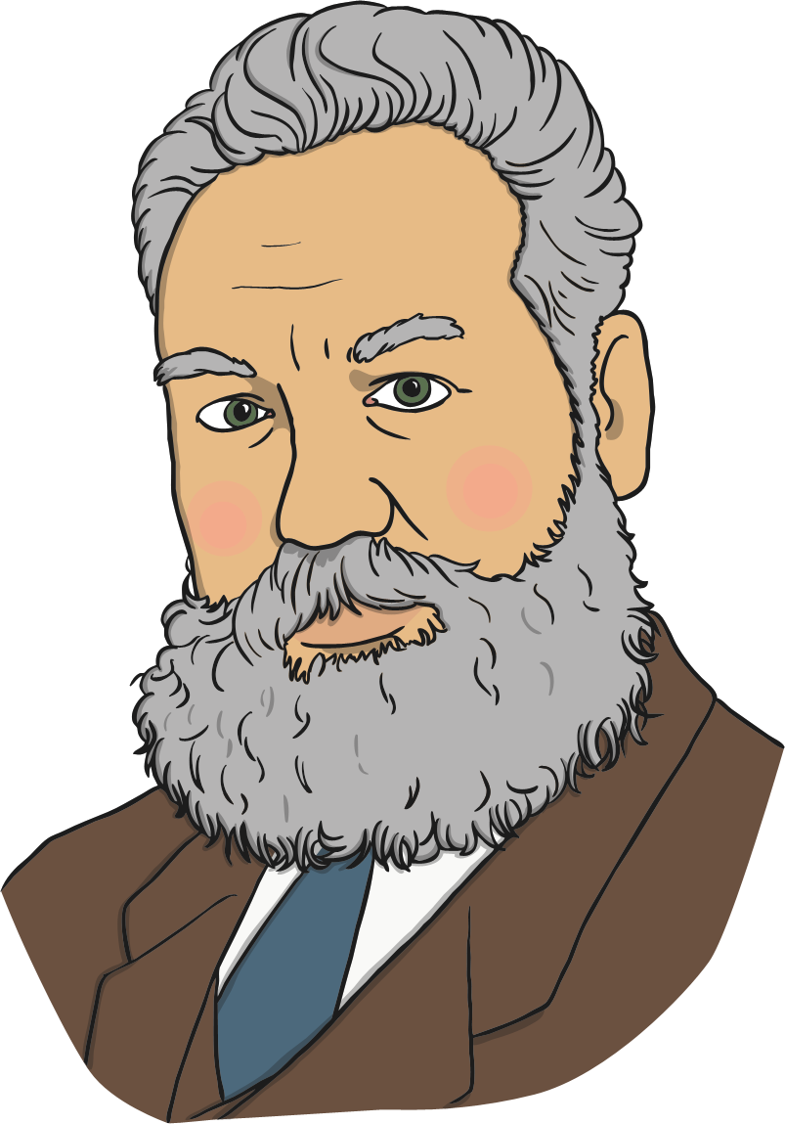
The Telephone
On 10th March 1876, Alexander and Thomas were working in separate rooms. Bell made the first ever telephone call, saying:
“Mr Watson, come here. I want to see you!”

Slide 5
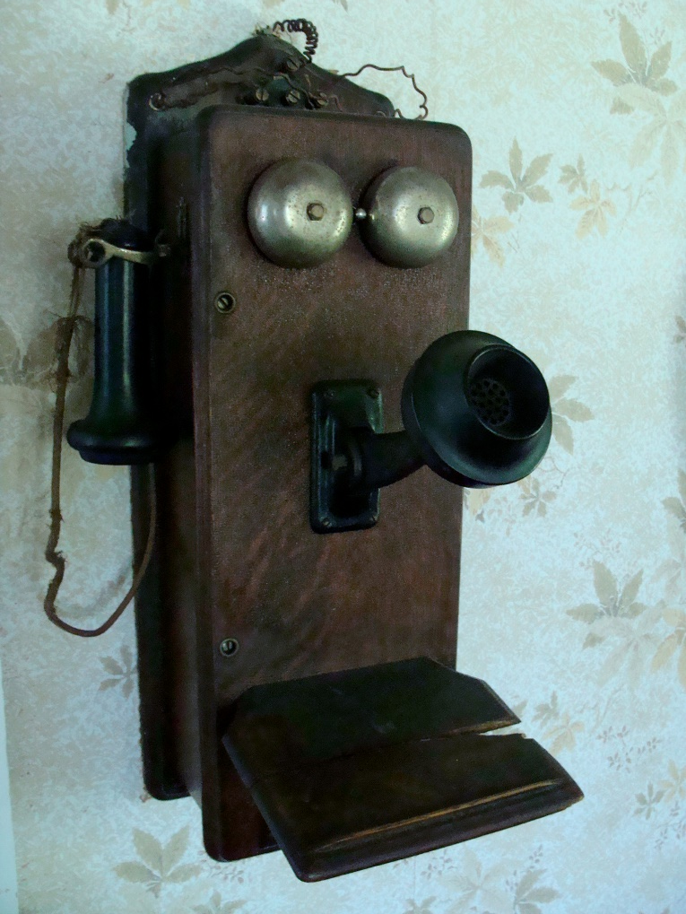
The Telephone
Following this success, Bell began to demonstrate his telephone in a series of public shows.
The Bell Telephone Company was set up in 1877, and by 1886 over 150,000 people in the USA owned telephones.
Photo courtesy of mackaycartoons (@flickr.com) - granted under creative commons licence – attribution

Slide 6
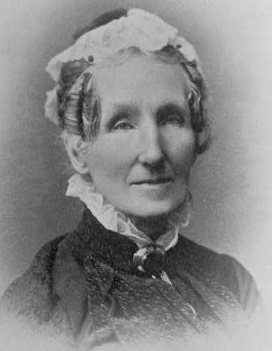
Work with Deaf People
Alexander Graham Bell’s mother was deaf.
Bell’s father worked with deaf people, and developed a system known as ‘Visible Speech’ to show how different speech sounds are made. At that time, ‘Visible Speech’ was thought of as an excellent way to help deaf people learn and develop their speech, although its use gradually stopped after about twelve years.
Bell helped demonstrate how Visible Speech could be used, and helped his father teach it to deaf people.
Eliza Symonds Bell, Alexander Graham Bell’s mother
Photo courtesy of findagrave (@findagrave.com) - granted under creative commons licence – attribution

Slide 7
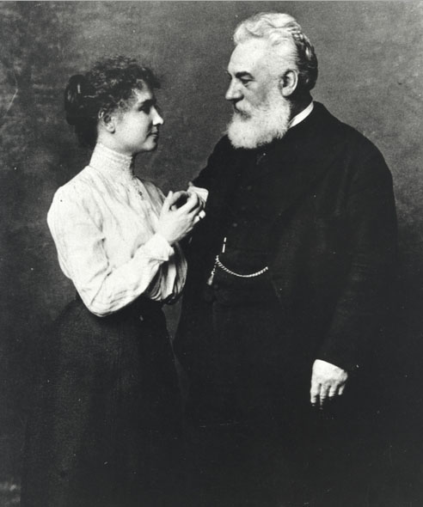
Work with Deaf People
In 1871, Bell travelled to Boston in America to train teachers at the School for the Deaf.
In 1872, he opened his own School for the Deaf. His first class had around thirty pupils, including Helen Keller, who became the first deaf and blind person to earn a university degree.
Keller and Bell
Photo courtesy of itupictures (@flikr.com) - granted under creative commons licence – attribution

Slide 8
Work with Sound
While working with his father, Alexander Graham Bell became very interested in speech and how we make sounds.
He and his brothers invented an ‘automaton’ - a mechanical man. Using bellows to push air through its windpipe, they could make it ‘speak’ a few words. Their neighbours all came to see and were amazed by it!
At the age of nineteen, Bell conducted some experiments with tuning forks, to explore how sounds are transmitted.

Slide 9
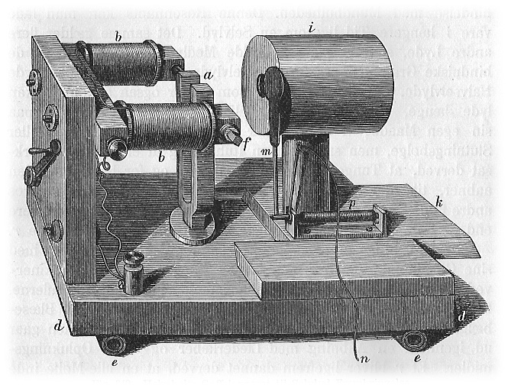
Work with Sound
He wrote a report of his findings and sent it to his father’s colleague, Alexander Ellis. Ellis wrote back to tell Bell that his experiments were similar to some that had already been done by Hermann von Helmholtz in Germany, and sent him a copy of the report of those experiments.
Bell was very disappointed that Helmholtz had already published his ideas. He saw his diagrams and came up with a new idea based on Helmholtz’s work. He started to concentrate on using electricity to transmit sound.
The Helmholtz resonator, from a paper written in German which Bell could not read
Photo courtesy of Historisk Fysik bind I (@wikipedia.com) - granted under creative commons licence – attribution

Slide 10
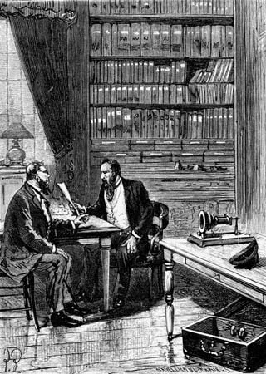
Controversy
Alexander Graham Bell was not the only person working on the telephone during the 1870s. Several scientists claimed that they had actually invented the first telephone, not Bell.
Bell had filed a patent for his telephone in February 1876. A patent is a document that gives an inventor the right to prevent other inventors from making, using or selling the same invention without asking.
On the same day, a scientist called Elisha Grey had filed a patent caveat. This was not a full patent, but was a document to show that he would soon be filing a full patent.
Bell filing a patent for his telephone, seen on the table
Photo courtesy of thinkstock (@britannica.co.uk) - granted under creative commons licence – attribution

Slide 11
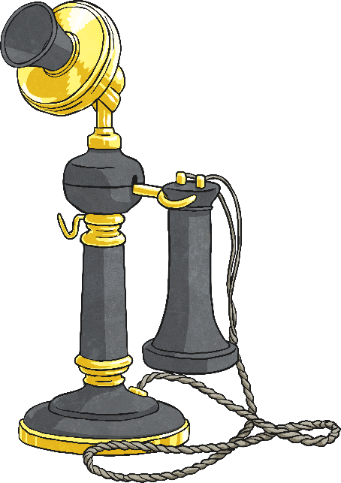
Controversy
Later, Elisha Grey felt that Alexander Graham Bell had stolen his ideas and used them to get his telephone working. This had to be investigated by the patents office.
Bell’s claim to be the first inventor of the telephone was eventually approved in March 1876, and Grey abandoned his claim and his caveat.
Bell had to continue defending his idea from other scientists who claimed they had thought of it first.
Over eighteen years, the Bell Telephone Company faced over 550 patent challenges. None were successful and Alexander Graham Bell is still regarded as the inventor of the first successful telephone.

Slide 12
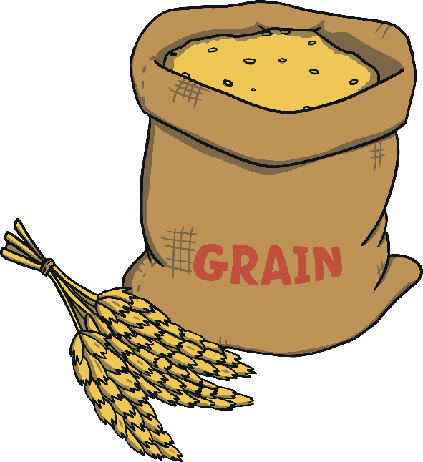
First Invention
Bell was very curious about the world at an early age and had a great ability to find solutions to problems.
The family of his friend and neighbour, Ben Herdman, ran a flour mill. While visiting the mill, Bell noticed the slow process of dehusking the wheat grain.
At age 12, Bell built his first invention to solve this problem. He created a device with rotating paddles and nail brushes that made it much easier and quicker to separate the grain from the husks.
His device was used in the mill for several years! As a thank you, the mill’s owner, John Herdman, allowed Bell to use a small workshop at the mill to create more inventions.

Slide 13
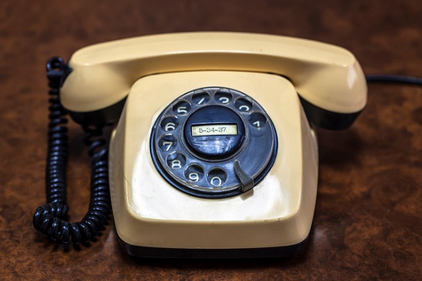
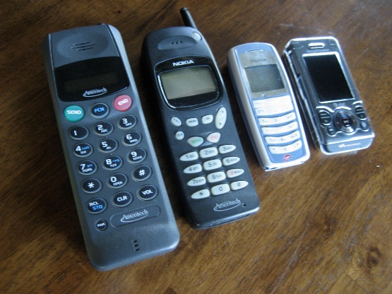
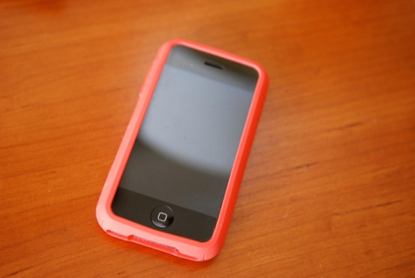
His Legacy
As the telephone became more and more important, so Alexander Graham Bell became more and more famous. He received many awards, medals and honours for his invention.
There are many museums and parks named after him, and Bell’s house in America is preserved as an historic site.
As Bell’s wealth grew, he used some of his money to set up laboratories and funds to help other scientists and young people.
Photos courtesy of Valery Chernodedov, rohdesign and hyku (@flikr.com) - granted under creative commons licence – attribution

Slide 14
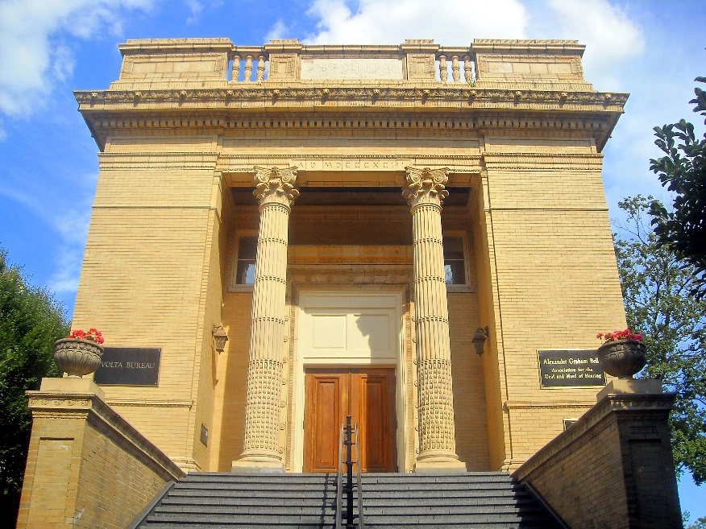
His Legacy
He set up a centre for study and research into deafness which is still active today in Washington.
Bell founded and became president of many societies, such as the National Geographic Society.
The measures of sound, the bel and the decibel, are named after him.
Bell died in 1922, aged 75.
After his funeral, every telephone on the continent of North America was silenced as a mark of respect for him.
Volta Bureau building in Washington, D.C – headquarters of the Alexander Graham Bell Association for the Deaf and Hard of Hearing
Photo courtesy of AgnosticPreachersKid (@wikipedia.com) - granted under creative commons licence – attribution

