Slide 1
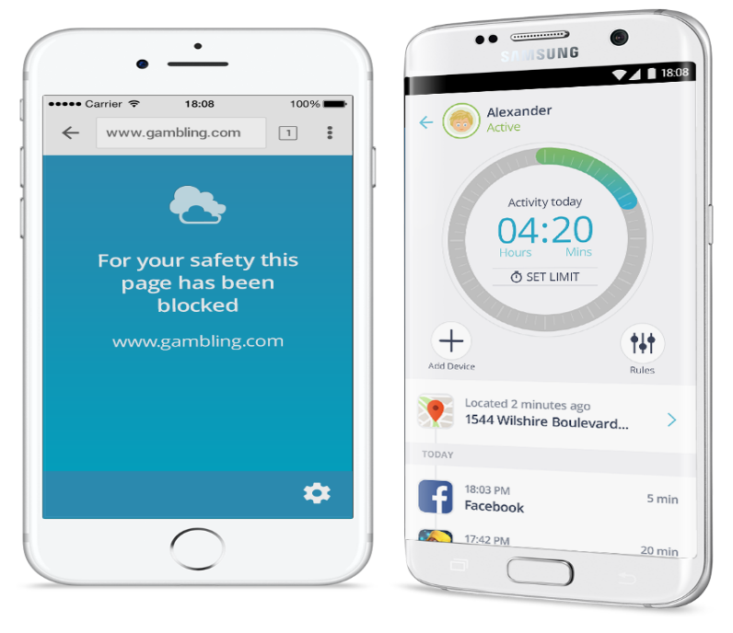
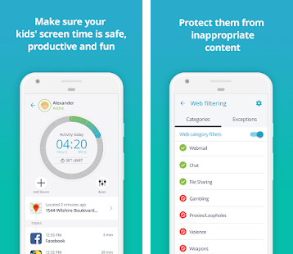
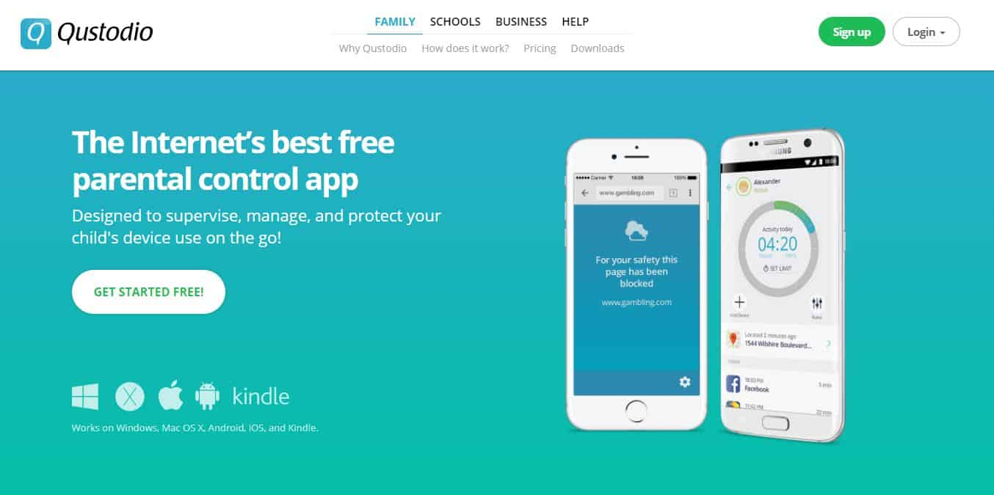
“Keeping your child's online experience safe, fun and productive.”
£3 a month for small families protects up to 5 devices - £35.95 annually.
Manage and limit your children's screen time by device
Monitor their activity on social networks
Monitor and block your children's calls
Track your child's device on a map
Limit games and apps and block inappropriate ones
Block inappropriate content with smart web filters
Panic Alert button for when your child is in danger
Start protecting your family today!
Get Full Visibility & Build Your Family's Digital Wellbeing

