Slide 2
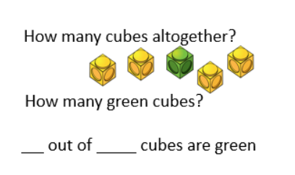
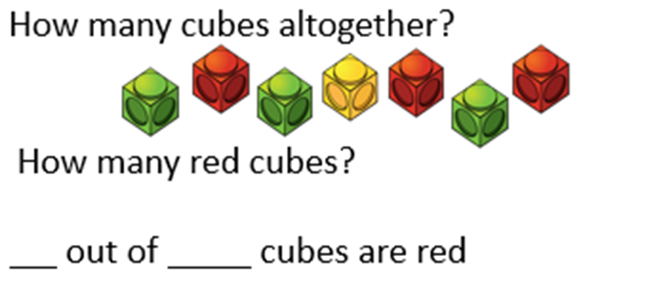
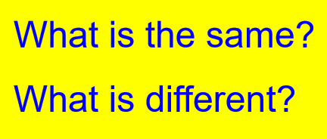

Slide 3
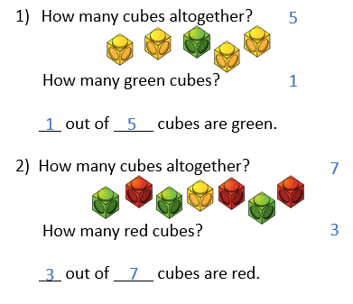

Slide 4
Numerator
How many parts we are looking at?
of the shapes are triangles.
Denominator
How many equal parts are there?

Slide 5
Numerator
How many parts we are looking at?
of the shapes are green.
Denominator
How many equal parts are there?

Slide 6
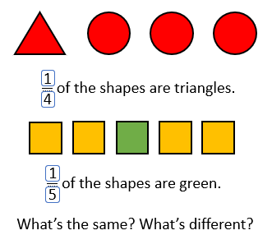

Slide 7
These are called unit fractions.
Unit fractions have a numerator of 1

Slide 8
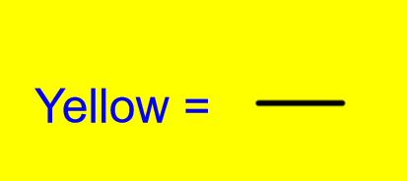
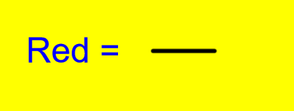

Slide 9
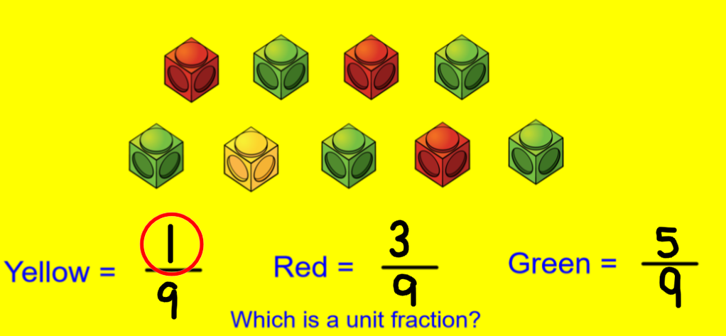

Slide 10
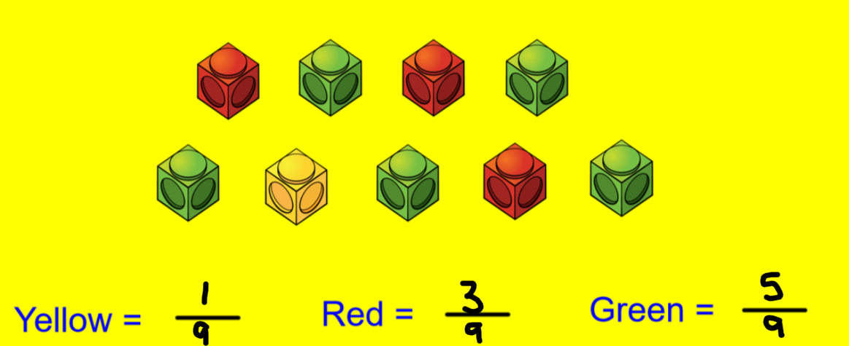

Slide 11
These fractions have a numerator greater than 1
These are called non-unit fractions.

Slide 12
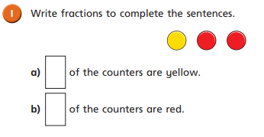
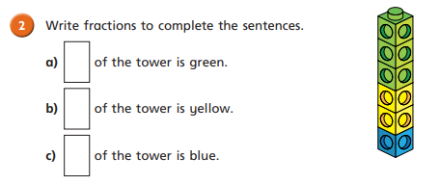

Slide 13
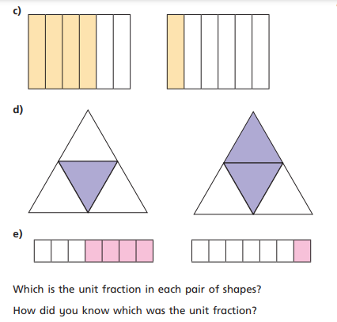
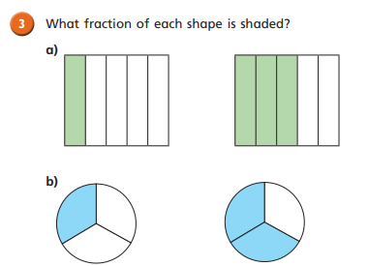

Slide 14
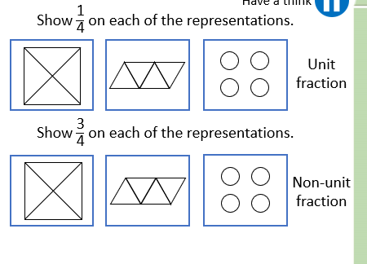
1

Slide 15
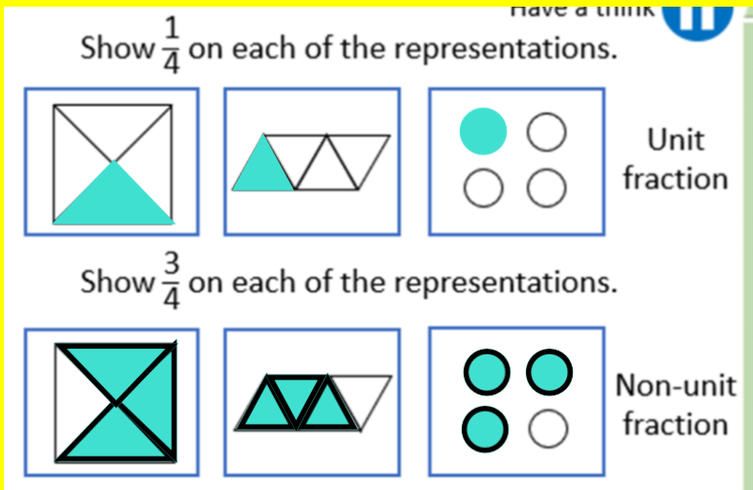

Slide 16
Show $\frac{\text{3}}{\text{4}}$ on each of the representations.

Slide 17
Show $\frac{\text{3}}{\text{4}}$ on each of the representations.

Slide 20
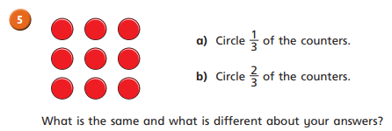

Slide 21
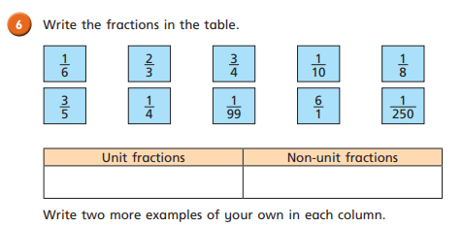
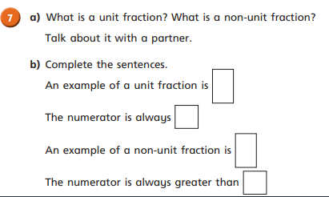

Slide 23
