Slide 3
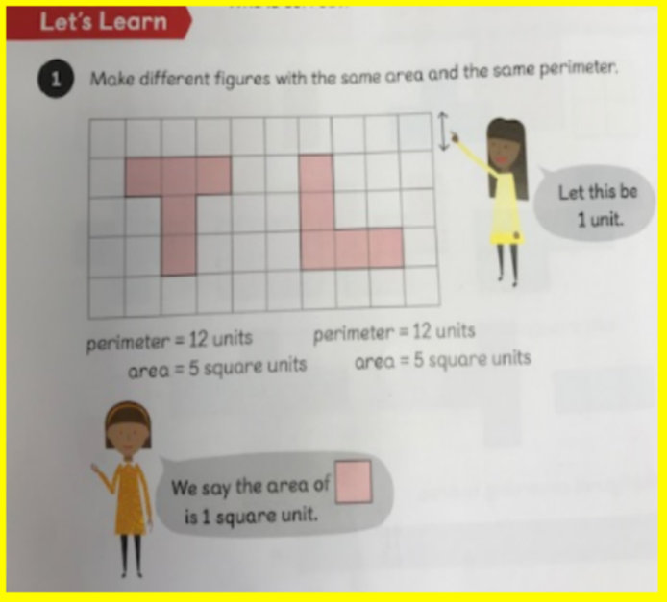

Slide 4
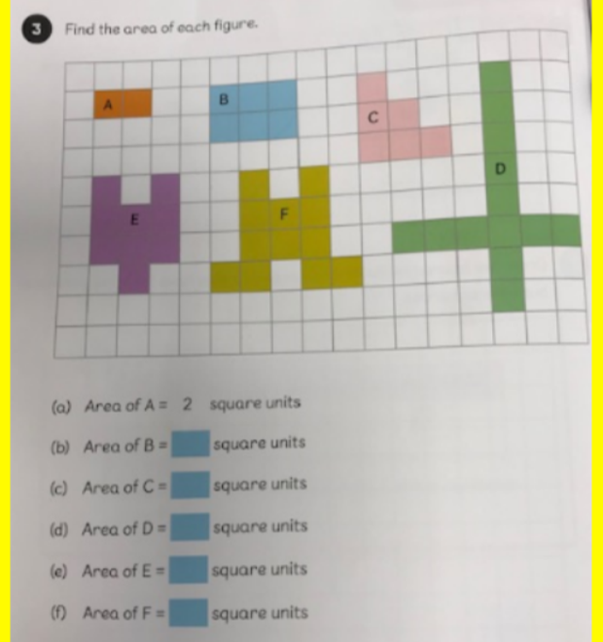

Slide 6
For each figure, find the area and perimeter and complete the table.

Slide 7
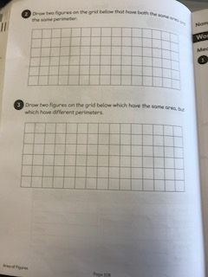

Slide 8
