Slide 2
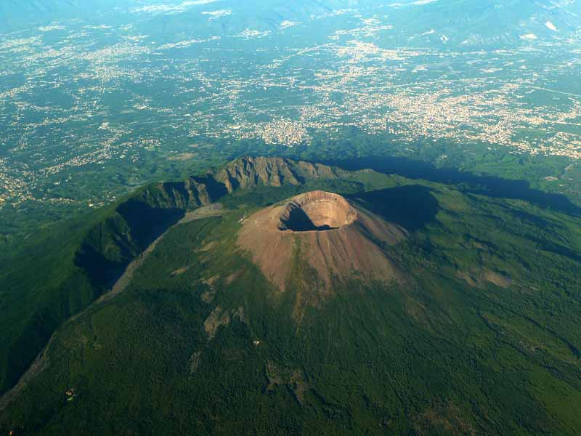
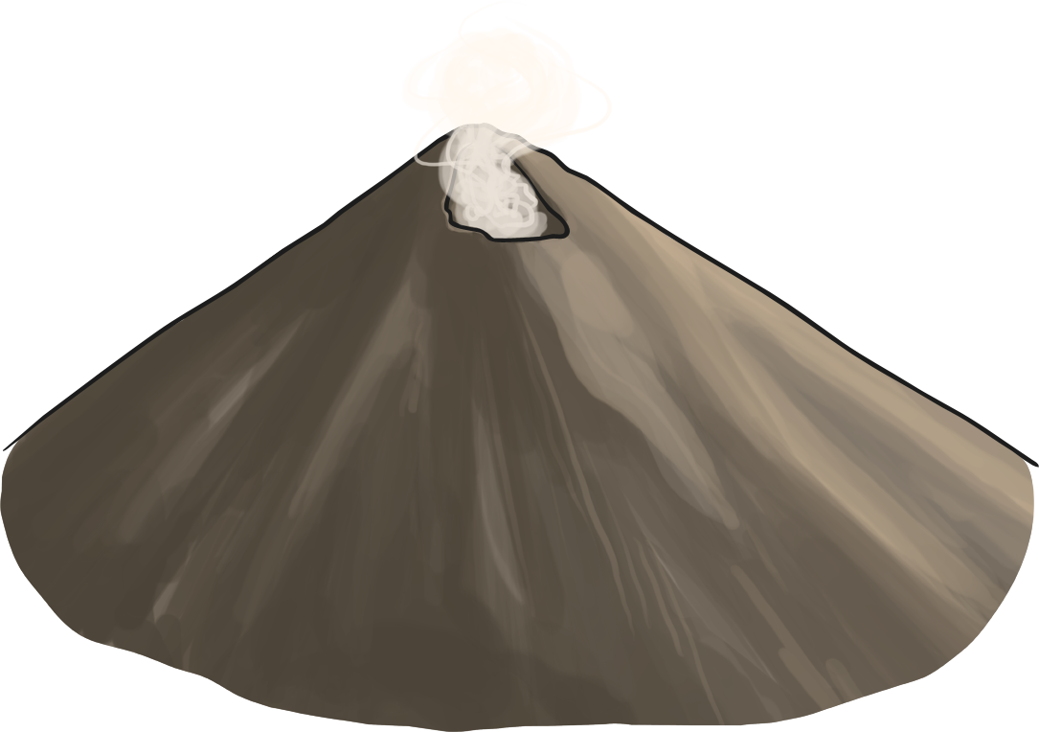
Mount Vesuvius is located on the Gulf of Naples, in Italy.
It is close to the coast and lies around 9km from the city of Naples.
Despite being the only active volcano on mainland Europe, and one of the most dangerous volcanoes, almost 3 million people live in the immediate area.
Did you know..?
Mount Vesuvius last erupted in 1944.
Photo courtesy of Ross Elliot(@flickr.com) - granted under creative commons licence – attribution

Slide 3
Mount Vesuvius is one of a number of volcanoes that form the Campanian volcanic arc. This is a series of volcanoes that are active, dormant or extinct.
Mount Vesuvius is actually a volcano within a volcano. Mount Somma is the remain of a large volcano, out of which Mount Vesuvius has grown.
Campi Flegrei
Vesuvius
Vulcano
Stromboli
Panarea
Etna
Campi Flegrei del Mar di Sicilia
Did you know..?
Mount Vesuvius is 1,281m high.
Mount Etna is another volcano in the Campanian arc. It is Europe’s most active volcano.

Slide 4
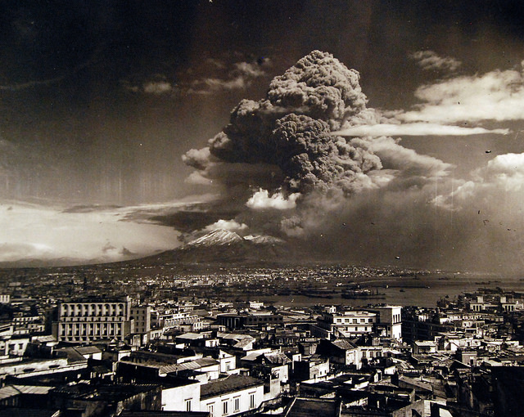
Mount Vesuvius last erupted in 1944. This was during the Second World War and the eruption caused great problems for the newly arrived Allied forces.
Aircraft were destroyed, an airbase was evacuated and 26 people died. Three villages were also destroyed.
1944 was the last recorded eruption but scientists continue to monitor activity as Mount Vesuvius is especially dangerous.
Did you know..?
During the 1944 eruption, the lava flow stopped at the steps of the local church in the village of San Giorgio a Cremano. The villagers call this a miracle!
Photo courtesy of National Museum of the U.S. Navy(@flickr.com) - granted under creative commons licence – attribution

Slide 5
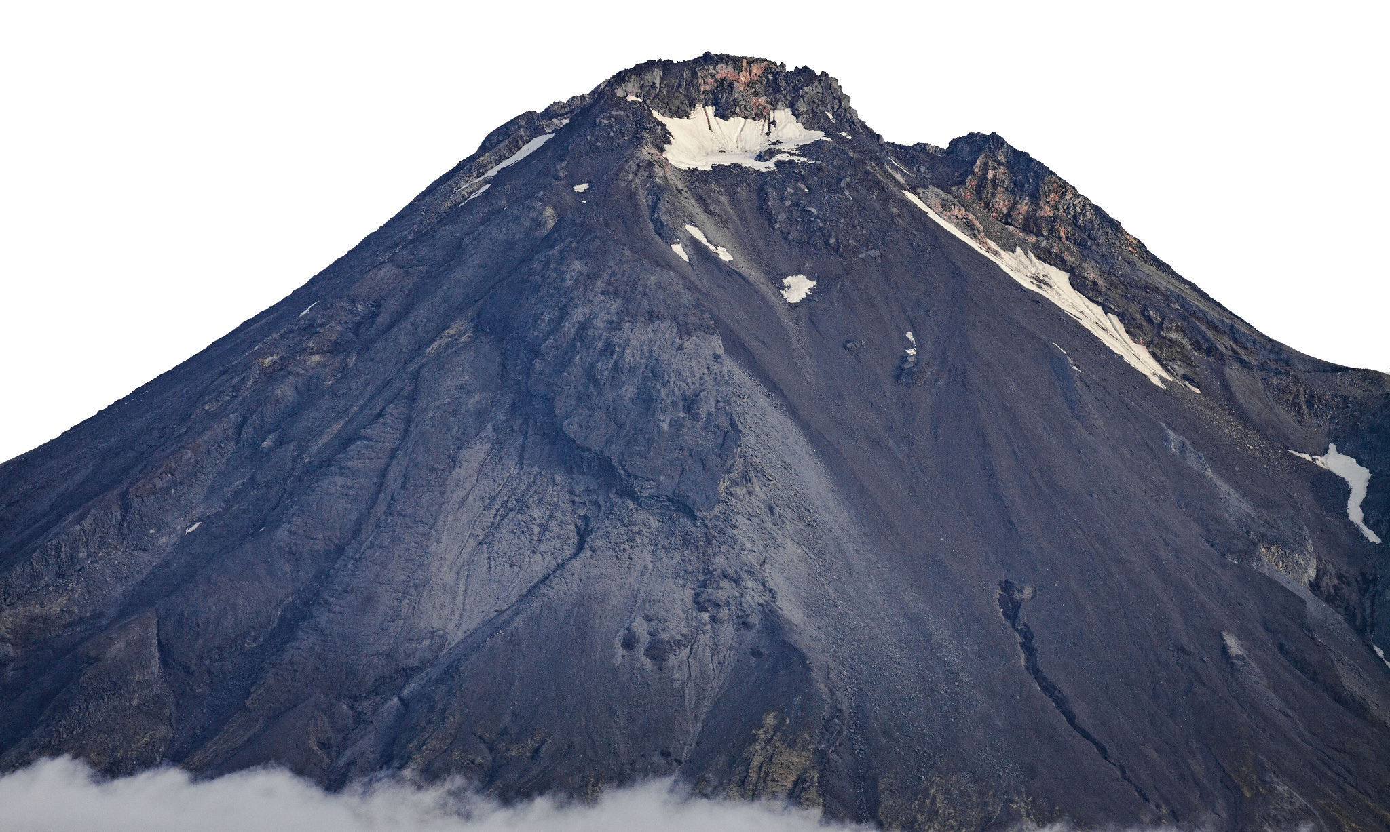
Mount Vesuvius is a stratovolcano.
Tall, conical shape.
Steep profile.
Explosive eruptions.
Composed of a layer of hardened lava and volcanic ash, which creates a danger of mud slides during eruptions.
Lava is highly viscous. This makes it cool and harden before it gets far.
Stratovolcanoes are the most common volcano type.
Causes more casualties than other volcano types.
Photo courtesy of Dave Young(@flickr.com) - granted under creative commons licence – attribution

Slide 6
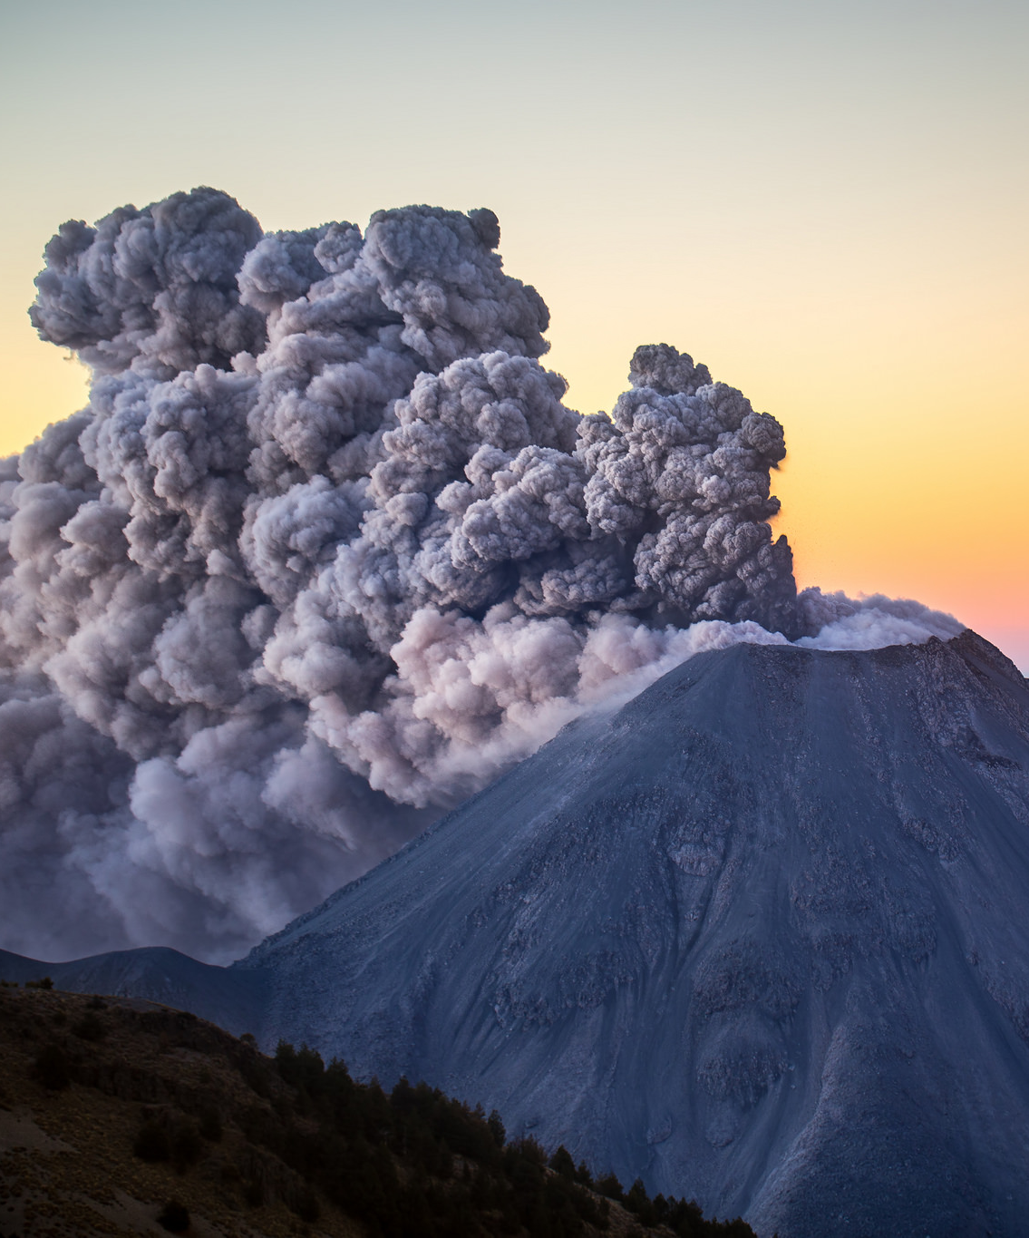
Although Mount Vesuvius has been relatively quiet since 1944, volcanologists believe it is a matter of when, not if, the volcano will erupt again.
While the city of Naples lies around 9km away, volcanologists have predicted that in the event of an eruption, the pyroclastic flow containing hot ash, gas and rock, would take just less than 3 minutes to reach the city.
Photo courtesy of Christian Villicana(@flickr.com) - granted under creative commons licence – attribution

Slide 7
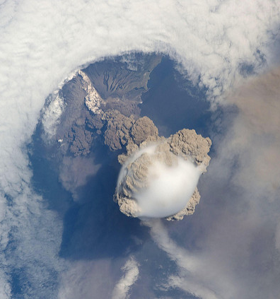
Plinian eruptions are huge explosions that create columns of gas, ash and rock that rises dozens of kilometres into the atmosphere. Because of this, the effects of a Plinian eruption have a greater reach.
The gas, ash and rock are known as pyroclastic flows and travel great distances at speeds of up to 100 miles per hour.
Clouds of hot ash, gas and rock as seen from space.
Photo courtesy of NASA Goddard Space Flight Center(@flickr.com) - granted under creative commons licence – attribution

Slide 8
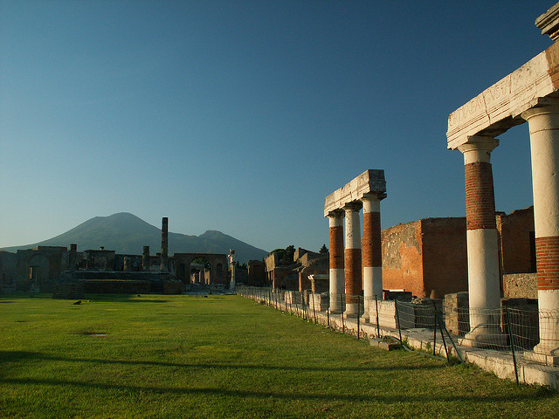
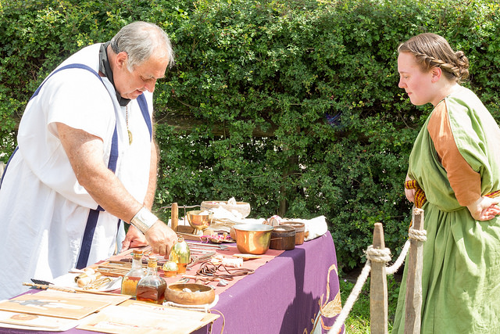
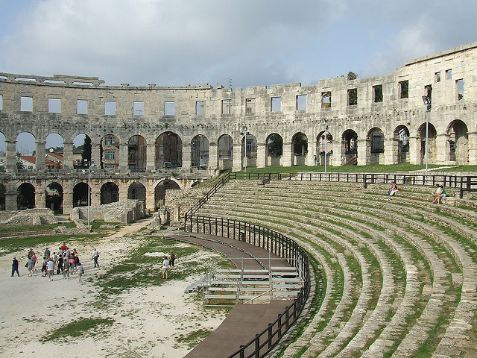
Mount Vesuvius is probably most famous for the 79 AD eruption that destroyed the Roman towns of Pompeii and Herculaneum.
Pompeii was a bustling Roman city, with grand stone buildings, temples and a forum. The streets were paved and even had the luxury of running water.
On the 24th August 79AD, the streets would have been bustling with people shopping, trading and going about their everyday routines.
Photo courtesy of Hardo Muller, Hans Splinter, Chris Yunker(@flickr.com) - granted under creative commons licence – attribution

Slide 9
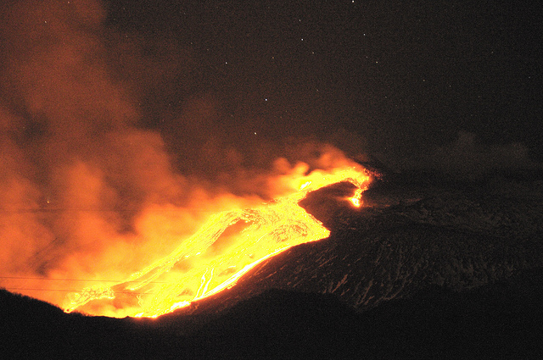
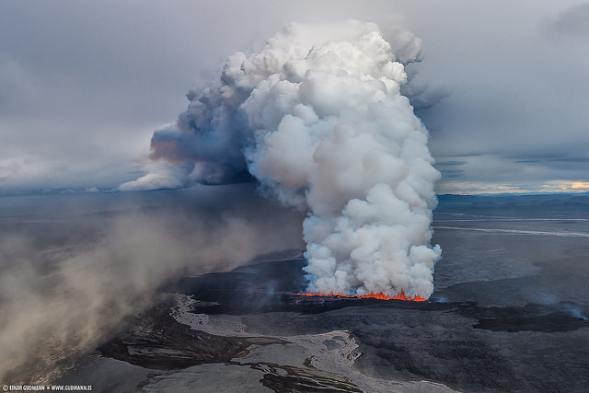
Mount Vesuvius had not erupted for hundreds of years - many people were unaware it was even a volcano.
Farmers worked the rich, fertile soils on the slopes of the mountain.
The first sign of trouble came in the afternoon with a huge explosion. Rocks, ash and lava were hurled into the air.
Lava began to flow down the slopes but people were not immediately concerned, believing they were safe in the city.
Photo courtesy of gnuckx, Sparkle Motion(@flickr.com) - granted under creative commons licence – attribution

Slide 10
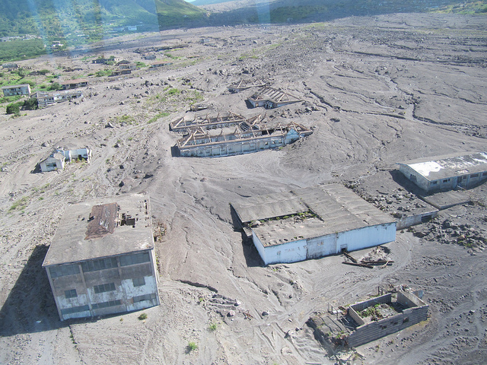
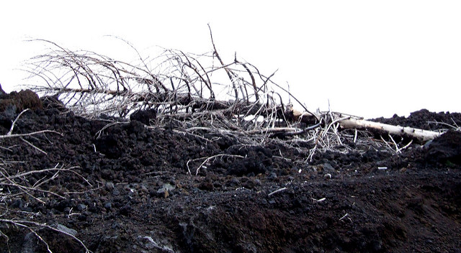
Eighteen hours after the first eruption, there was another. This time the eruption had such force, one side of the mountain blew up. A huge cloud of rock, ash and gas hurtled down the slopes towards Pompeii.
The citizens tried to flee. But it was too late.
The citizens were buried in seconds where they stood, in a layer of ash around 9m thick.
Photo courtesy of Leonora (Ellie) Enking, gnuckx(@flickr.com) - granted under creative commons licence – attribution

Slide 11
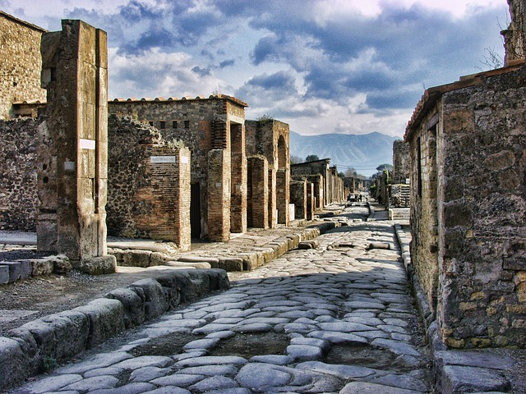
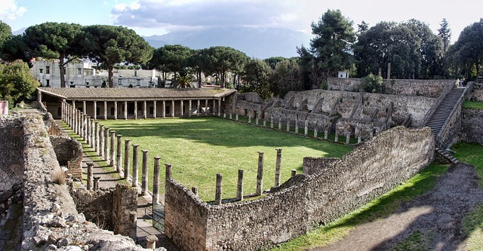
Because the area around Mount Vesuvius remained uninhabitable, the towns of Pompeii and Herculaneum were undiscovered until 1748.
Nearly 2000 years later in 1997, the whole city of Pompeii was finally uncovered.
Today you can walk the paved streets of the Roman towns and marvel at the stone and concrete structures that were preserved in the volcanic ash.
Photo courtesy of Graham-H(@pixabay.com) - granted under creative commons licence – attribution

Slide 12
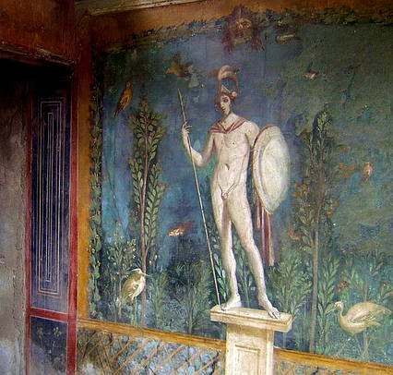
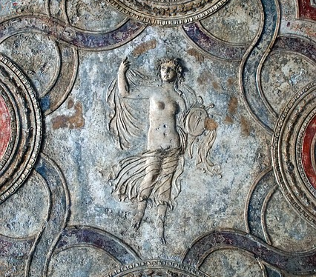
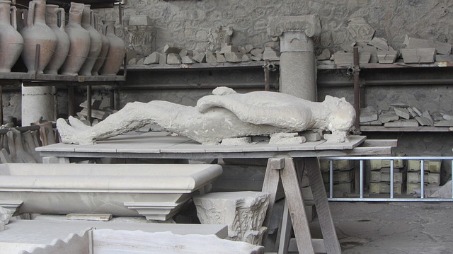
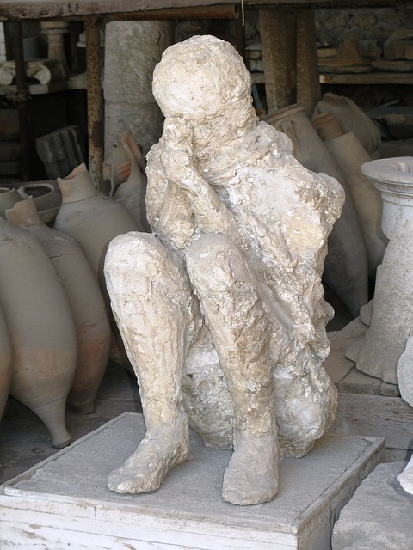
Archaeologists were also amazed to discover the imprints of the bodies of the citizens. They made plaster casts of these that show where the people fell on the day of the eruption.
Visitors to Pompeii can observe beautifully preserved mosaics and paintings. These artefacts help us understand more about Roman life.
Photo courtesy of k6gmf6, Wingrid1979, travelspot, SCAPIN(@flickr.com) - granted under creative commons licence – attribution

Slide 13
Glossary
Active volcano A volcano that has had at least one eruption during the past 10,000 years.
Archaeologist A person who studies human history and prehistory through the excavation of sites and the analysis of artefacts and other physical remains.
Dormant volcano Volcanoes that are quiet, but might possibly erupt again.
Extinct volcano Volcanoes that have not had an eruption for at least 10,000 years and are not expected to erupt again.
Plinian eruption Eruptions named after the Roman writer, Pliny the Younger who wrote the only eye witness account of his uncle, Pliny the Elder, who witnessed the 79AD eruption.

Slide 14
Glossary
Pyroclastic flow Very hot ash, lava fragments, and gases that come from a volcano, typically flowing at great speed.
Stratovolcano A volcano built up of layers of lava and ash.
Viscous A thick, sticky consistency between solid and liquid.
Volcanologist A geologist who studies the formation and eruptive activity of volcanoes and their current and historic eruptions.

