Slide 5
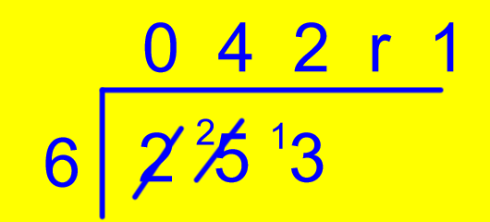

Slide 13
Kettle
£63
Toaster

Slide 20
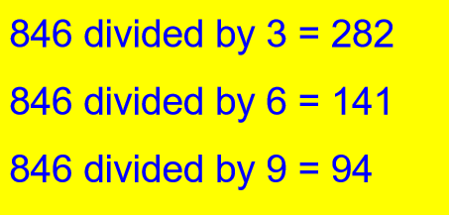

Slide 22
= 61
= 61
= 61
= 60

Slide 24
False. 921 can be divided equally by 3 but not 6.
True
True

